Slide 1
IRP, Inc. Update
IFTA Annual Business Meeting
August 15, 2019
Raleigh, North Carolina
Dawn Lietz Tim Adams
IRP, Inc. Board Chair IRP, Inc. CEO

Slide 2
IRP, Inc. Update
IRP, Inc. Executive Leadership
  Dawn Lietz Chair
  Jeff Hood Vice Chair
  Jay Sween Treasurer
  Kevin Davis Secretary
  Scott Greenawalt Past Chair
IRP, Inc. Board Leadership
  Tammi Popp Director
  James Walker Director
  Portia Manley Director
  Renee Kyser Director
  Paul Harbottle Director
  Rotating Position Open
  Canadian Position Open

Slide 3
IRP Clearinghouse Netting

Slide 4
IRP, Inc. Update
Defining the Roadmap to the Future
Enhancing Motor Carrier Service Community Engagement
Developing a Strategic Path
Pursuing Innovative Technologies
Enhancing Service to the Membership
Promoting Efficiencies, Compliance and Safety

Slide 5

IRP, Inc. Road to the Future
WHO WE ARE
Commercial vehicle registration reciprocity agreement amongst 59 US and Canadian Jurisdictions.
Over 2.9 million vehicles
Over 351,000 fleets
Improving HWY Safety
Facilitating Commerce
OUR MISSION
To promote and encourage safe and efficient use of the highway system.
OUR VALUES
      Integrity
      Resources
      Partnerships
      Collaboration
      Action
      Responsiveness
      Engagement
      Safety

Slide 6



IRP Roadmap
Innovative Solutions:
Clearinghouse/Data Repository
Process Improvement
Enforcement
Education and Training
Community Engagement:
Collaboration and Inclusiveness
Effective Communications
Member Support
Informed Community
Sound Governance:
Risk Management
Fiscal Integrity
Succession Planning
Improving Knowledge of IRP
Plan Integrity

Slide 7
So, how did we get here?
Board Directed Strategic Path Exercise
  Included working with consultant
  One on one stakeholder interviews
  Membership survey
  Meetings of Board to work through process

Slide 8
What we learned
IRP Today:
Today, the 48 contiguous United States, the District of Columbia and 10 Canadian provinces are all members of IRP and participate in the Plan, which authorizes registration of more than 2.95 million commercial vehicles and facilitates the collection and payments of more than $3 billon per year.
Beyond these performance numbers, a recent IRP member survey confirms that IRP – the Plan and IRP, Inc. – are providing a valuable service to members and the industry as both an important agreement and highly effective organization. This includes important ongoing work on several modernization initiatives. Survey highlights include:
  69% feel satisfied with IRP, Inc.
  71% feel satisfied with IRP, the Plan.
  79% feel IRP, Inc. brings value to their work institutions.
  82% feel IRP, the Plan brings value to their work institutions.
  87% feel the Plan supports jurisdictions and 78% feel the Plan supports industry.
  There is great deal of support for IRP’s modernization initiatives.
  Most member’s want IRP to stay ahead of the curve, and not get run over by it.

Slide 9
What we learned
IRP’s Future:
IRP’s operational performance and findings from the recent member survey point to two major insights. First, IRP the Plan and IRP, Inc. are operating from a position of strength in terms of financial stability and member support. Second, the future represents the most significant challenge facing IRP - how to remain a vital resource to jurisdictional members and the industry in the face of major trends and marketplace shifts. The arrival of fully autonomous trucks, the growth of the Internet of Things (I of T), artificial intelligence, and blockchain technology will usher in significant changes to the industry and vehicle registration. The conclusion is that there is no better time for IRP to think about tomorrow than today.
To this end, the IRP Board has outlined a planning process to map IRP’s future. The goal of this work is to formulate a long-term plan that will help IRP successfully navigate and leverage the major trends reshaping the commercial freight industry. The over-arching goal of this plan is to ensure that IRP not only maintains its relevancy, but becomes an even more valuable resource to its members and the industry.
During IRP’s past two annual meetings, IRP engaged SIR and its Institute for Tomorrow to share insights and lead member discussion on some of the key trends shaping the future of transportation. (Information on SIR can be found at www.sirhq.com and https://www.institutefortomorrow.com/)

Slide 10
Most IRP Members Want IRP to Stay Ahead of the Curve, and Not Get Run Over by It.
What we learned
Some of what the IRP member survey responses:
“The only way to attract the new generation to this field is to
be more tech driven and being open to new ways of doing things.”
“IRP needs to lead the charge in leveraging technology to ease reporting requirements and help to ensure proper reporting and therefore proper fees are paid and distributed to all jurisdictions.”

Slide 11
Member responses
“Keep the ball moving forward. Continue to be flexible and think outside of the box on ways to reach members and keep members engaged. It’s an ongoing, iterative process.”
“Keep looking forward and embracing technology while
leveraging work that partners have already done.”

Slide 12
Major Initiatives
Clearinghouse Modernization/Data Repository
Electronic Verification of Operating Credentials (EVOC)
Education and Training / Learning Management System (LMS)
Synergies with IFTA

Slide 13
Current Status of Initiatives
Clearinghouse Modernization/Data Repository
  Contracted with Project Management Consulting Team from the University of Kentucky – Kentucky Transportation Center
  Modernization W/G appointed to work through process of defining requirements and developing RFP
  Modernization Oversight group established
  W/G engaged in bi-monthly conference calls
  Face to face meeting schedule for early September 2019
  Work well underway to hopefully have RFP out in late Spring 2020

Slide 14
Current Status of Initiatives
EVOC
  Task Force continues efforts to identify processes for EVOC
  Draft ballot being considered for needed changes to the Plan
  Will include system capability in IRP CH/Data Repository for electronic validation of IRP credentials
  Working with LE partners to identify systems currently used to determine what all options are out there

Slide 15
Current Status of Initiatives
Education and Training - LMS
  Evaluating membership needs and desires
  Looking at various options for different systems we can consider to meet the need
  Hope to have options defined for the Board to make a decision on in the coming months
  Also, hope to explore working jointly with IFTA

Slide 16
Current Status of Initiatives
Synergies with IFTA
  Keeping open communications between our respective organizations
  Welcome the opportunity to find areas for joint efforts that provide enhanced service and benefit to the memberships

Slide 17
Other Initiatives
IRP Finance Working Group
  Group met on August 1st to look at current finances, trends and begin to evaluate the future needs of IRP, Inc. to continue to provide services and to enhance what we bring to the membership
    Succession Planning
    Future staffing needs
    Potential funding models for membership consideration
    Long term sustainability

Slide 18
Membership Engagement
How can you be part of these exciting times?
  Volunteer for vacant positions on committees/board
  Stay informed through the IRP Newsline and other correspondence
  Participate in the IRP Forum, Virtual Roundtables, Managers Huddle, IRP Certificate Program, Various Webinars, etc.
  Send your thoughts and ideas to appropriate committee chairs???
  Attend meetings and workshops???

Slide 19
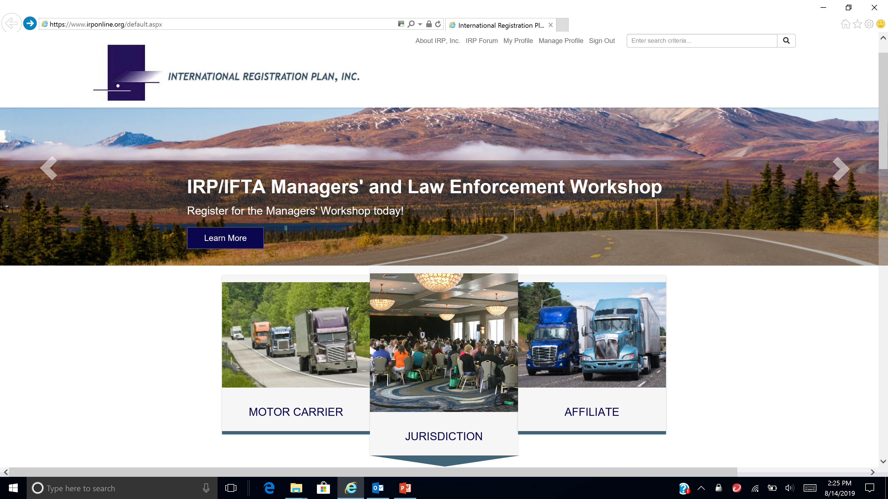
IRP Website

Slide 20
Upcoming IRP Events
IRP/IFTA Managers and LE Workshop – Orlando, Florida – September 10-12, 2019
IRP Board of Directors Fall Meeting – Lake Tahoe, Nevada – October 2-3, 2019
IRP Board of Directors Winter Meeting – Palm Springs, California – January 22-23, 2020
2020 IRP Annual Meeting – St. Paul, Minnesota – May 5-7, 2020

Slide 21
IRP Update
Thank you!!
QUESTIONS / Comments

